Slide 1

COURSE INSIGHTS
A Data Science Pipeline for Educational Platforms
Saada Asghar 2112125
Tooba Mushtaq 2112136
Duaa Ali 2112109
Mahnoor Hasan 2112135
Rohail Rathore 2012362

Slide 2

ABSTRACT
Understanding the Basics
Extracted, cleaned, and analyzed data from:
Coursera, FutureLearn, OpenLearn
Goals:
Analyze trends in course popularity, ratings, and behavior
Visualize insights for stakeholders
Identify trends (e.g., course categories, ratings, pricing)
Visualize data through Power BI
Predict future trends

Slide 3
DATASET
Coursera - 720 Records
FutureLearn - 213 Records
Fields Scrapped:
OpenUniversity - 1441 Records
Course Title, Rating, Reviews, Level/Type, Price, Duration, Category, Source of the Course

Slide 4
THE SCRAPING AND CLEANING PROCESS
Scraping
Cleaning
Duplicate Removal
Handling Missing Data
Standardization (e.g., Pricing, Duration)
Datatype conversions
Tool and Libraries
BeautifulSoup , Requests, Pandas
Scraped course cards containing:
Title, University, Type , Price (e.g., free/paid), Image URL etc.
Stored extracted links for additional data collection.
For each course link, gathered more detailed information.
Fields Extracted: Title, Rating, Modules, Reviews
Tool and Libraries
Pandas

Slide 5

DATA ANALYSIS
Descriptive Statistics: Summary of ratings, prices, and enrollments.
Category Analysis: Identified top-performing course categories.
Correlation Analysis: Examined relationships between features such as ratings, price, and duration.

Slide 6
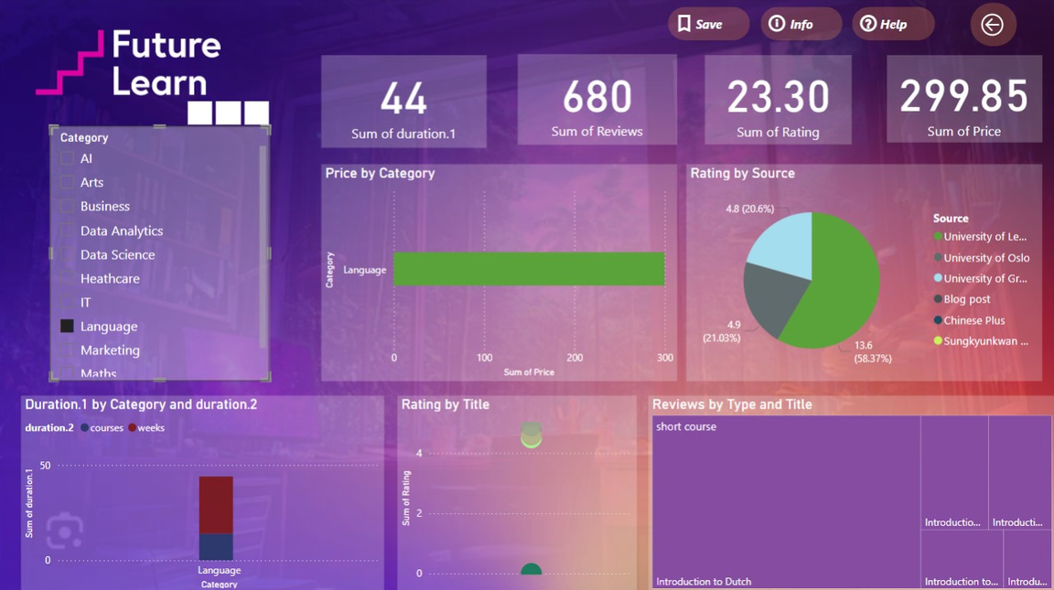
DATA
VISUALIZATION
Key Insights:
High-rated courses have 20% higher enrollments
Free courses see 30% more enrollments
Visuals:
Ratings Distribution, Pricing Trends, Top Categories
Making Data Understandable
Interactive Features:
Course Ratings by Category
Pricing Distribution (Free vs. Paid)
KPIs for top courses and enrollment metrics
Filters for exploration

Slide 7
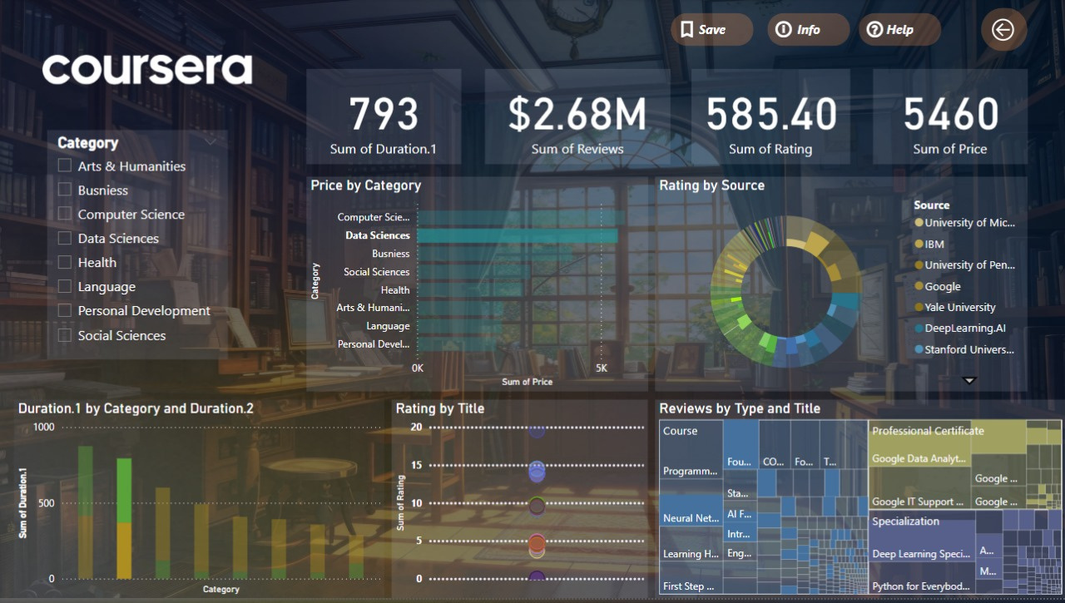
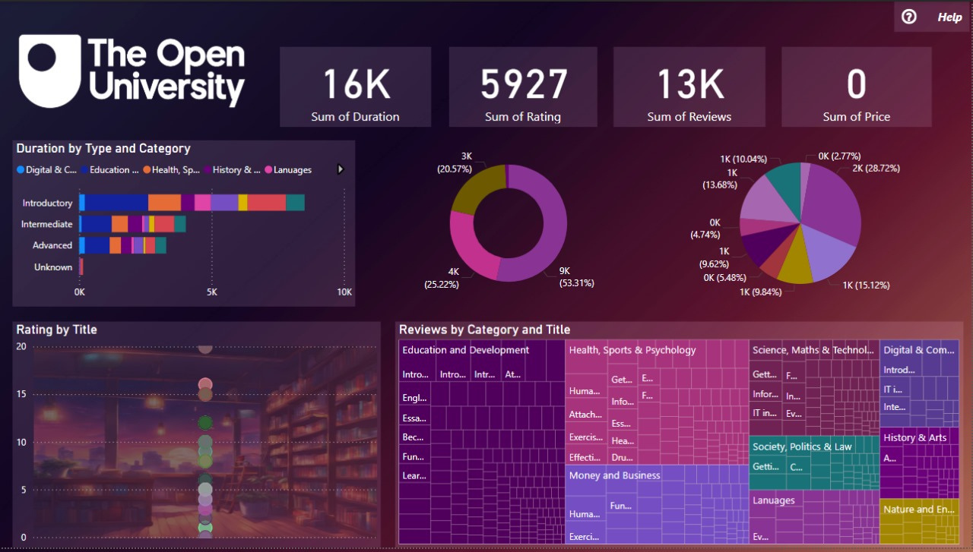

Slide 8
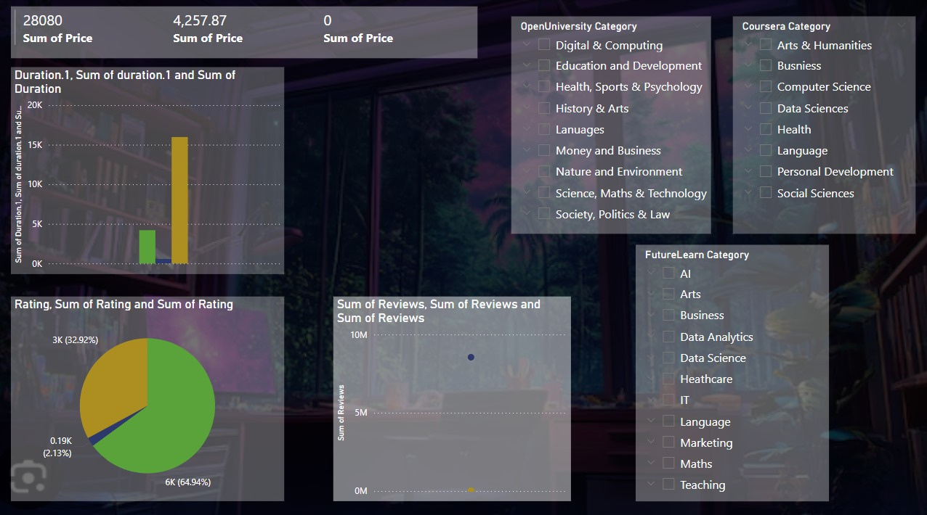
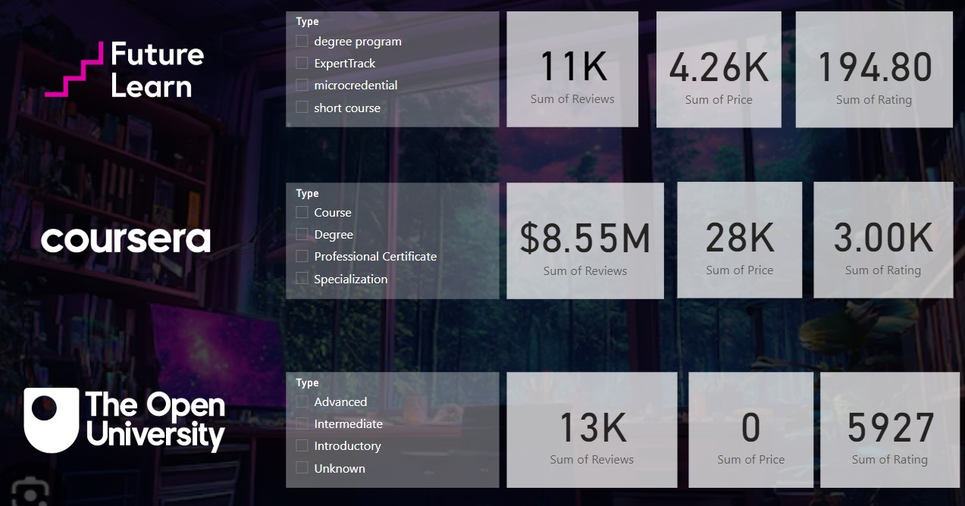

Slide 9

CONCLUSION
The Future of Data Analysis
The project successfully extracted, cleaned, and analyzed 2374 records from three platforms, uncovering key trends in course popularity, pricing, and user engagement. By creating an interactive dashboard, stakeholders can now explore actionable insights to make data-driven decisions. Future extensions will include real-time API integrations and advanced predictive models for deeper analysis.

Slide 10
THANK YOU

